Slide 1




PLoRa: A Passive Long-Range Data Networks from Ambient LoRa Transmissions
Yao Peng*, Longfei Shangguan★,
Yue Hu*, Yujie Qian*, Xianshang Lin*, Xiaojiang Chen*, Dingyi Fang*, Kyle Jamieson★
★ Princeton University *Northwest University
Notes:
Good afternoon everyone. today I will be telling you about PLoRa, an ambient backscatter system that can enable a long range wireless connectivity for batteryless IoT device. This is joint work with NISL lab in northwest unversity and PAWS in princeton unversity.

Slide 2
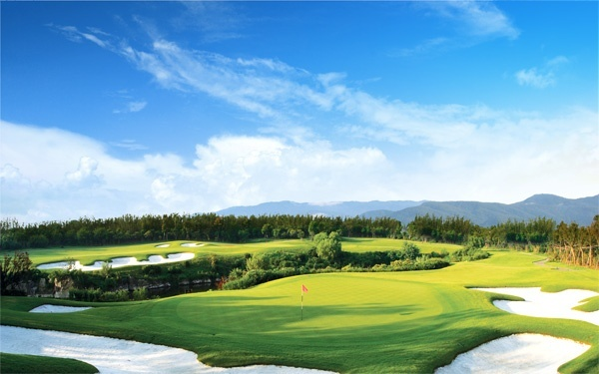
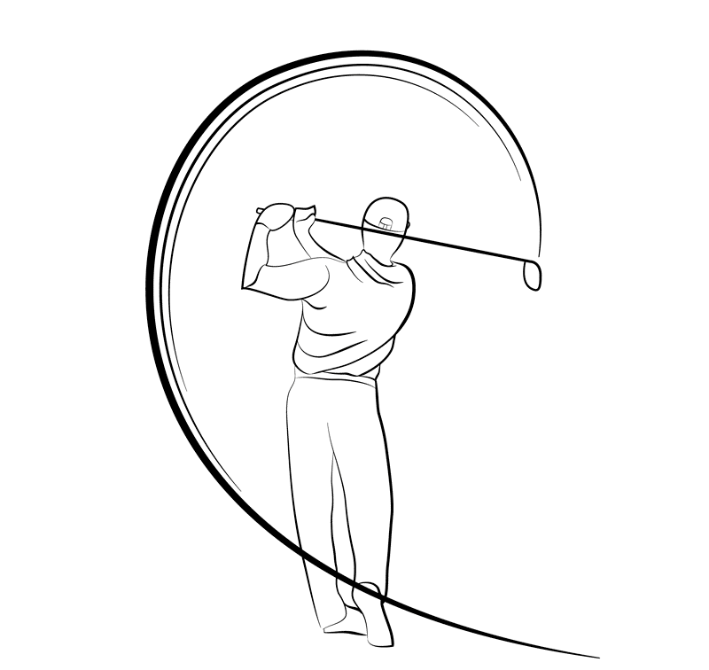
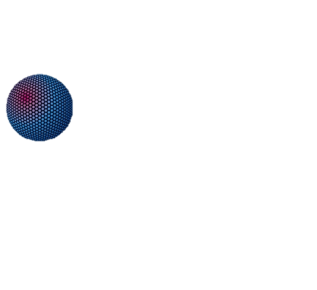

Motivation
…1111000101…
Angle sensor
θ
Accelerometer
…1000110111…
Pressure Sensor
…1001101011…
Position
…101110101101…
Intelligent Sports Training
Notes:
This research is motivated by a simple question: Can we Imagine a world where every single object is connected to the Internet ubiquitous and cheap?
It will bring convenient and comfortable life to us.
For instance, When we are playing golf, iot tag collects data and recording the trace of moving golf ball. These data can help us to play golf in a correct way and it will monitor our health index.

Slide 3
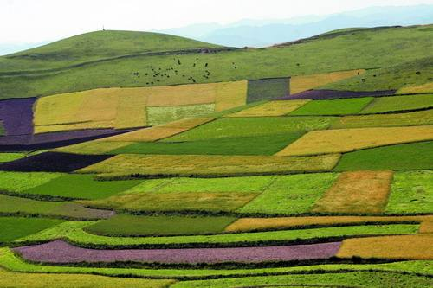
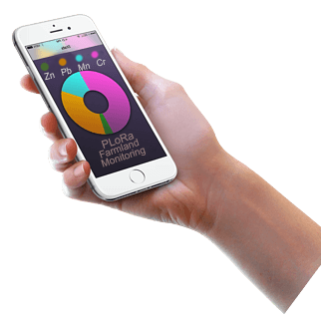
Motivation
66 %
4.1 ℃
PH = 6.2
Zn = 0.02
Pb =0.01
……
66 %
4.1 ℃
PH = 6.2
Zn = 0.02
Pb =0.01
……
Smart Agriculture
66 %
4.1 ℃
PH = 6.2
Zn = 0.02
Pb =0.01
……
66 %
4.1 ℃
PH = 6.2
Zn = 0.02
Pb =0.01
……
Notes:
It provides status data of the farmland to help farmers managing there crops: temperature, soil moisture content and PH values.
A key to this vision is the wireless communication technology that enables extremely impoverished IoT devices to continuously exchange low-rate data.

Slide 4



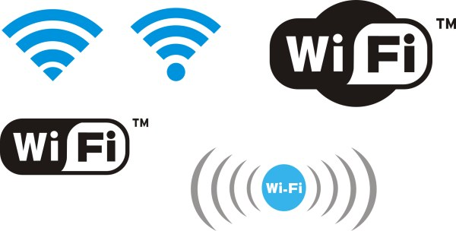





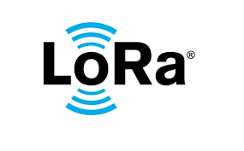





Observation 1
Bit Rate
Wi-Fi/BT
Cellular
Mbps
LoRa:
Low Power,
Long Range,
and Cheap.
------
Kbps
Short Range
LPWAN
bps
10m
100m
1km
10km
Distance
Notes:
We discover two observations in Wireless signal and protocol.
First one, There are many popular wireless communication protocol and signal with different modulation method in this 2D diagram. the X axis present transmission distance as the y axis is bit rate.
It’s easy to get that:Power consumption, data rates and transmission diatsnce is competitive with each other. There is no wireless solution satisfying three requirements simultaneously: Low power, high transmission bit rate and long distance
Low Power Wide Area is more and more popular in recent years. LoRa、Sigfox、Weightless and NBIoT are in this area.
As LoRa is not in the ISM frequency band. It makes LoRa communication cheap than others is this area. It’s easy to conclud thatL lora is a low power long range and cheap wireless iot solution.

Slide 5
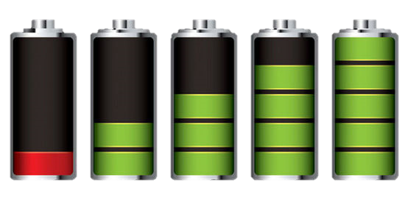
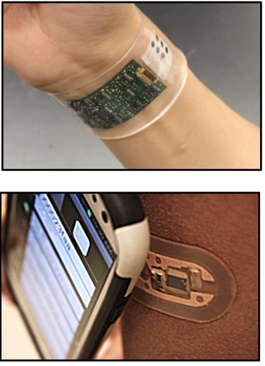
Observation 2
Battery Limitation
Distance Limitation
Special Excitation Device
Figures by Rose, Bandodkar et al.
Notes:
Sencod observation: to the best of our knowledge, no existing wireless technology the following three requirements: Battery-free, Long-range and Ambient excitation signal.
Commercial device is selected, the backscatter distance will be limited in dozens of meters
Quantity of Energy is limited.
Existing technique using special excitation to achieve communication distance. It’s very expensive and costly

Slide 6
PLoRa
Battery free system
Takes ambient LoRa signal as excitation signals
conveys data to gateway far away
Notes:
So, we built the system PLoRa.
it takes ambient LoRa transmissions as the excitation signals, conveys data by modulating an excitation signal into a new standard LoRa “chirp” signal, and shifts this new signal to a different LoRa channel. Then the gateway far away receive data transmitting by our Passive tag.
It achieves this by a holistic RF front end hardware and software design,including a low-power packet detection circuit, a blind chirp modulation algorithm and a low-power energy management circuit.
It performs kilometer-scale data transmisson and deliver 284 bytes data every 24 minutes indoors, or every 17 minutes outdoors.
It works even if the person is behind the wall and doesn’t require her to hold or wear any device.
It integrates a light-weight backscatter signal decoding algorithm with a MAC-layer protocol. Then PLoRa tags and active LoRa nodes are coexistence and work together to form a complete ambient LoRa backscatter network

Slide 7
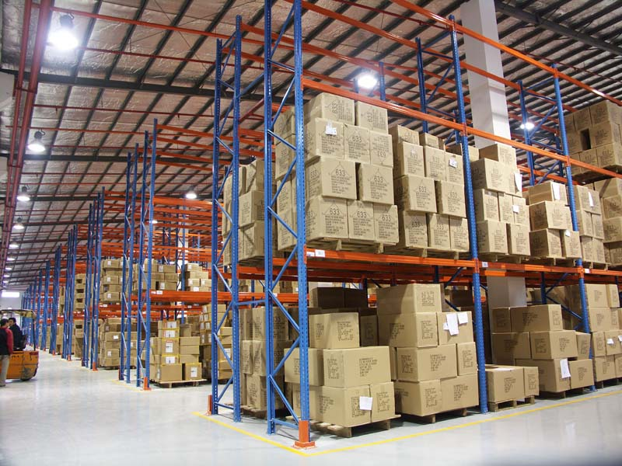

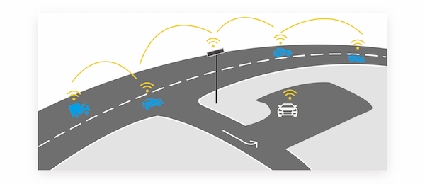
Application
Smart Warehouse
Wildlife Tracking
Intelligent Transportation
Notes:
And our system can be used in wildlife tracking, smart warehouse and intelligent transportation without battery renewal and special equipment deployment.
Golden monkey conservation area. Monitor the environment of the conservation area to prevent disease cause by environmental change
Xi’an ancient city wall , to monitor the factors inducing erosion of the ming great wall

Slide 8
Problem
How to built PLoRa, a battery free ambient backscatter long-range communication system?
Notes:
The key problem is how to build the system satifying these three requirements: battery free, commercial excitation signal and long range backscatter distance
So This problem can be divided into three sub-questions:
How to detect commercial LoRa Package?
How to implement the Low power Modulation
And how to satisfy tightly Energy constraints in our system

Slide 9

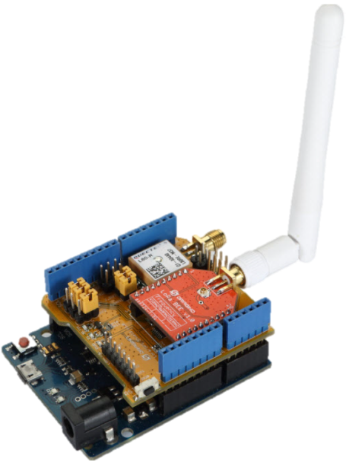
1 How to detect commercial LoRa Package?
Z
.
.
.
Z
Package arrival time is unknown
Z
Wake up passive tag
Special Excitation Device
PK 1
PK 2
PK 3
PK 4
Commercial LoRa Device
tc1
tc2
tc3
ts1 ≠ ts2 ≠ ts3, LoRa features are continuous changing
9
Notes:
For the existing long range backscatter system, for instance lora backscatter and lorea, they using special excitaion device to generate sine sodual signal. It’s easy to be modulated to target signal symbol. But the device is expensive and hard to deployed.
We selected standard lora signal generated by commercial lora device. And the commercial lora packet is like that:
It is easy to find that
amplitudeo

Slide 10
Commercial LoRa receiver
14dbm
LNA
Σ-Δ ADC
Mixer
FFT
32Mhz OSC
High power consumption!
Notes:
These solution is not fit our tightly energy constraints.

Slide 11
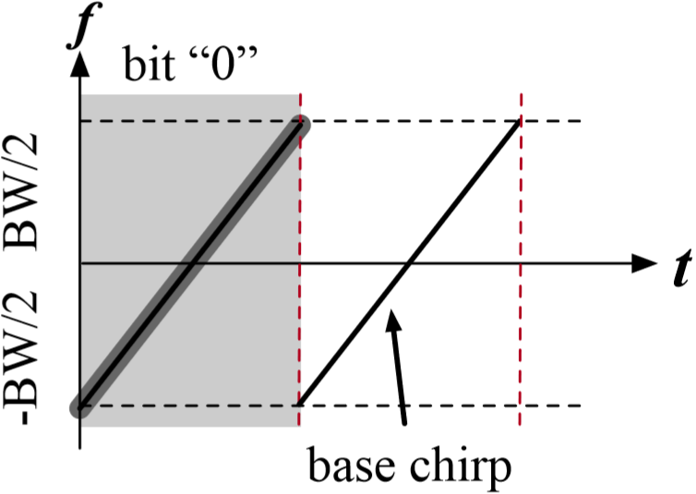
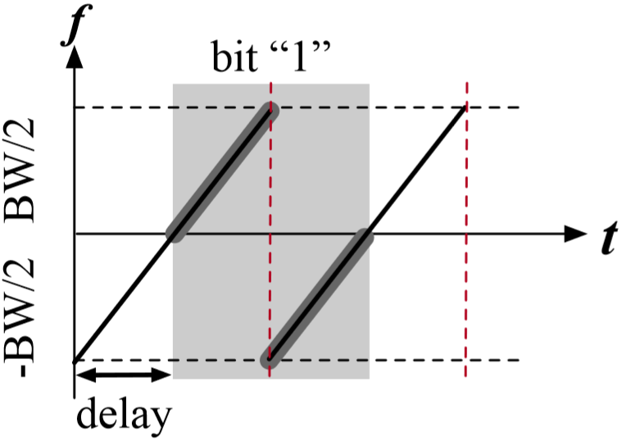
2 Low power Modulation
All chirp signals are a slice of continuous base chirp with equal length window.
Notes:
LoRa selected Chirp Spread Spectrum modulaion to achieve long range transmission distance and high SNR.
Look at this standard lora signal diagram. this symbol represent data 0 and other is data 1. We can easily get that: each symbol has equal length window.
As excitation signal is ambient lora signal, it is changing over time. It is thus challenging to modulate this time-varying excitation signal into another standard LoRa chirp for backscatter
As battery free, the energy is scarce for passive system.how to Modulate the commercial signal while ensuring continuous spreading in full lora bandwidth with tightly energy constraint? It’s a important problem.

Slide 12
3 Energy constraint
Vibration
ENERGY
HARVESTING
Temperature
Mechanical
Light
RF
Notes:
As battery free, we get energy from ambient circumstance. Energy harvesting techniques can potentially provide perpetual energy supply to the tag, but often limited: electric quantity is limited, EH is effected by surrounding, and energy leakage is existing.
For instance,
Solar…
Rf…
And so on

Slide 13
.
.
Z
.
Z
Z
Energy Leak
Notes:
As shown in picture, energy leakage in systems is existing while the system sleeping.

Slide 14
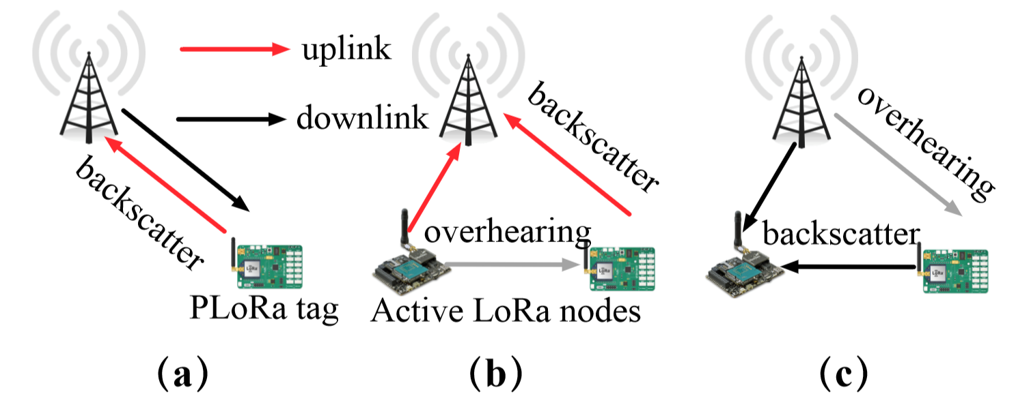
Design
Communication System architecture
PLoRa communicate with both active LoRa nodes and gateways.
(a)Conventional backscatter.
(b)Opportunistic uplink piggybacking
(c)Opportunistic downlink piggybacking
Notes:
----Let me explain our communication system architecture------3 transmission modules
In this way, we form a hybrid LoRa network with the existing LoRa infrastructure cooperating with PLoRa nodes .

Slide 15
Design
Packet detection
Blind chirp modulation and frequency splicing
Energy harvesting and management
Notes:
Now, let’s talk about our deisgn. It construct by 3 main blocks.
Design：EH and management, packet detector and modulation, as well as eH and management.

Slide 16
How to Detect The Commercial LoRa Signal?
f
A
t
t
10111111
10111111
10111111
10111111
10111010
10111101
10111111
10110100
10110111
10111000
10111001
10011011
10100011
10110000
10011010
10100111
10011111
10100111
10110000
10010111
10010111
10011011
10011001
10011011
10001011
10001000
10011001
10001001
10001001
10000111
10000011
10000011
10000011
Notes:
Under tightly energy constraint
Low power solution is important.
We extract the standard lora preamble feature by lots of simulation and data analysis.
then we restore these feature data in fpga.
Using correlation method to implement

Slide 17
How to Detect The Commercial LoRa Signal?
Noise
LoRa Chirp
Best Matching
Detecting the LoRa excitation sent from
the transmitter 50m away.
Correlation
Notes:
Once the lora signal is coming, our ptag will receive it. And the signal will propagate Through envelop detector , then low power downsample ADC. After that, we get the feature of excitation signal. And we compare the feature with what we have stored.
The best matching part will be the a standard upchirp.

Slide 18
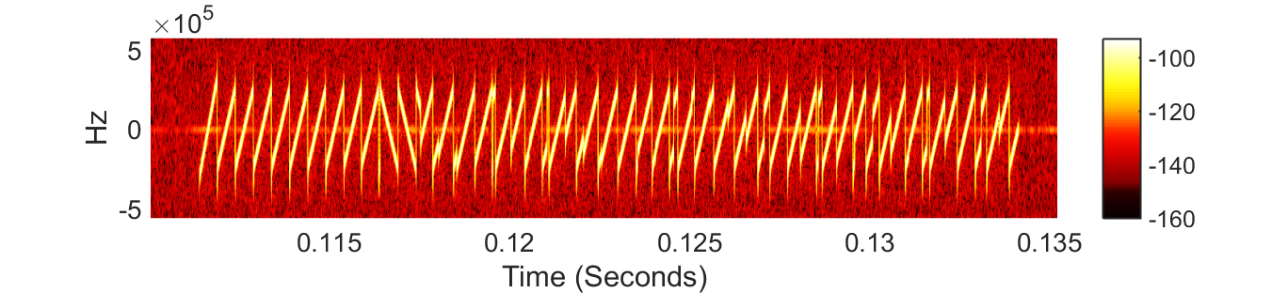
How to Detect The Commercial LoRa Signal?
LoRa Preamble
Chirp
2
3
1
8
10
5
4
9
X
6
LoRa Package
is Detected!
7
Notes:
we do a correlation there. it help us to find the packet header. The correlation detecting will not stop until all upchirp in lora packet header are deteced. We already get the packet header.

Slide 19
How to Carry Our Information
.
.
.
WAKE UP THE Modulation Block
Z
Z
Z
Sensor
Notes:
Once we have detected the package header, the modulation block is waken up.
Please note that the design is also under the tightly energy constraint.
As we don’t know what the incoming chirp looks like, it is thus difficult to modulate the incoming LoRa chirp into another standard chirp with our ptag information.

Slide 20
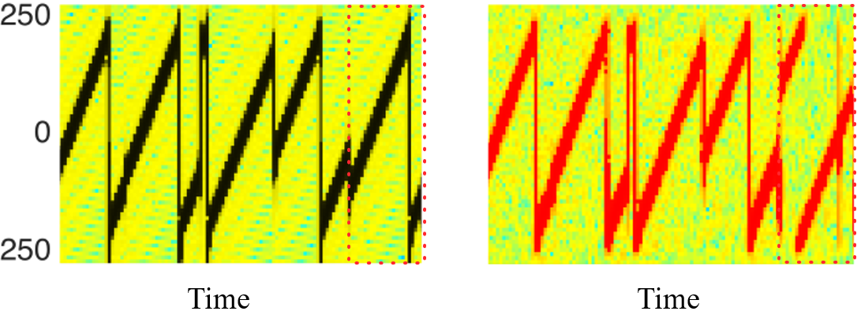
How to Carry Our Information
BEFORE MODULATE
Blind Chirp Modulation and
Splicing Technique
f1
f2
f1 = f0 + fshift + BW/2
Sensor
1
0
1
0
f2 = f0 + fshift - BW/2
…
Notes:
We design a novel blind chirp modulation algorithm to solve this challenge
The basic idea is to shift the incoming active LoRa chirp by an amount of BW/2 and −BW/2, and splice the in-band part of these two shifted LoRa chirps into a new chirp signal.

Slide 21
How to Carry Our Information
Blind Chirp Modulation and
Splicing Technique
f1
f2
f1 = f0 + fshift + BW/2
Sensor
0
1
0
f2 = f0 + fshift - BW/2
…
Notes:
We define the fsk modulation like this: when transmission data 1,we do modulation. And transmission data 0, we keep the original excitation signal.

Slide 22
How to Carry Our Information
f1
Blind Chirp Modulation and Splicing Technique
f2
f1 = f0 + fshift + BW/2
Sensor
1
0
f2 = f0 + fshift - BW/2

Slide 23
How to Carry Our Information
f1
AFTER MODULATE
f2
f1 = f0 + fshift + BW/2
Sensor
0
f2 = f0 + fshift - BW/2

Slide 24
USRP RECEIVED SIGNAL
250
250
0
0
Frequence (KHz)
Frequence (KHz)
-250
-250
0
0.5
0
0.5
0
0.5
0
0.5
0
0.5
0
0.5
Time (ms)
Time (ms)
BEFORE MODULATE
AFTER MODULATE
Notes:
原文图

Slide 25

How to Harvest Energy
Charging Pump
CHARGING
READY TO
DISCHARGE
DISCHARGING
Notes:
we come to the last design: EH & energy management.
we propose a hybrid eh system to harvest both solar energy and rf energy.
It improving charging time to 20minutes, which satisfies the duty-cycling requirement of most IoT systems.
To reduce energy leakage, we design a current gate to physically cut off circuit connectivity between the energy storage capacitor and all other system components.
The current gate is implemented by a finite state management circuits block.
The block manage the node state, switching between charging and discharging at the right moments to prevent data loss due to energy depletion

Slide 26
How to Harvest Energy
Charging Pump
CHARGING
READY TO
DISCHARGE
DISCHARGING
Notes:
It cut off a lot of static energy consumption

Slide 27
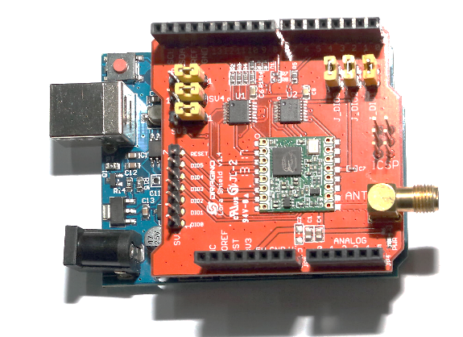
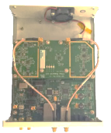
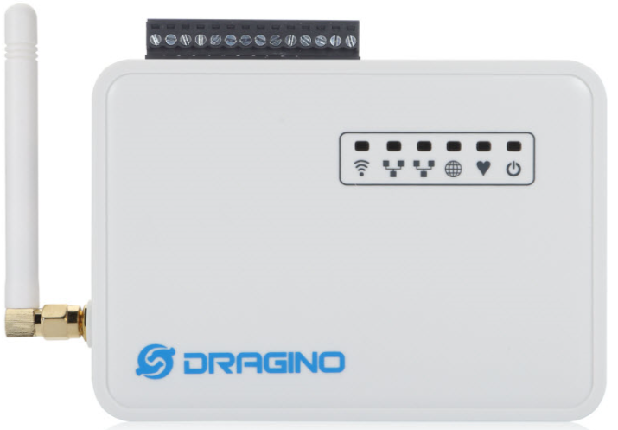
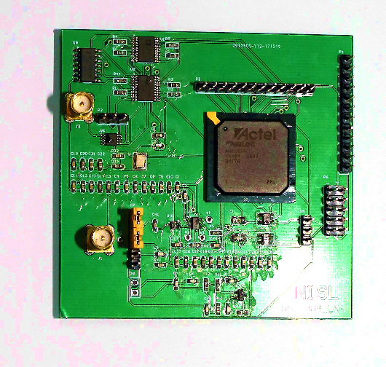
Implementation
Commercial Tx
LoRa Sx1276
USRP 2954
Commercial Rx
LoRa Gateway
PLoRa Tag
标签
TX
Notes:
To implement plora communication system, we built a hardware and software component.
We prototype the PLoRa tag on a four-layer PCB using commercial off-the-shelf components and a Microsemi IGLOO nano AGLE600V2-FG484I FPGA
simulation system, plora tag + hardware testbench, communication system

Slide 28
Evaluation
End to end field study
Networking performance
Power Consumption
Notes:
The evaluation includes three aspects：ee，np，pc, and We evaluate the system under both out door and in door situations.

Slide 29
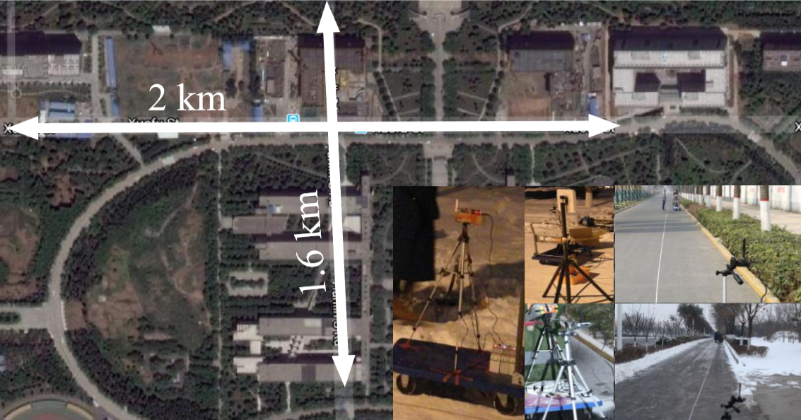
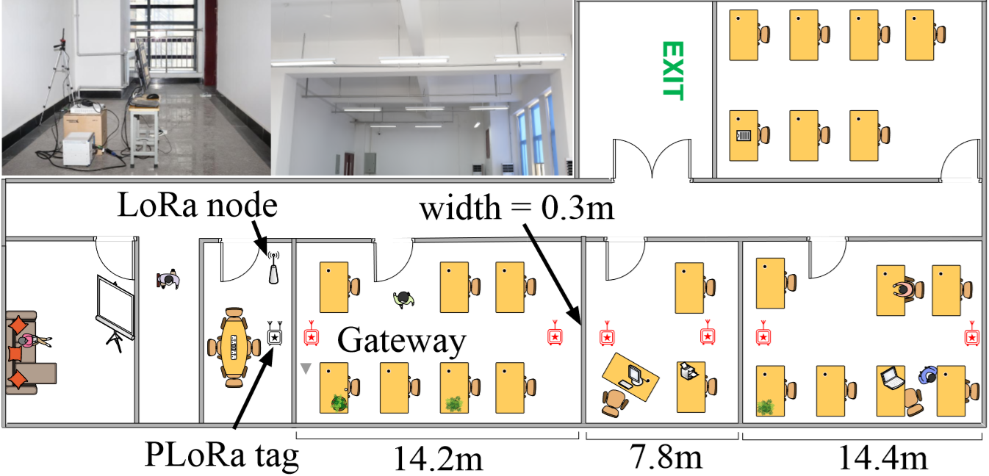
Experimental setup
OUTDOOR
INDOOR
Notes:
Experimental setup
OUTDOOR: We test the PLoRa tag’s performance in various weather conditions in an open road.
INDOOR: We put an active LoRa node and a PLoRa tag in the meeting room and move the receiver through several adjacent offices.
The noise floor in all experiments is around−60dBm to−70dBm due to P-GSM-900 cellular interference in the 900 MHz frequency band.
The default spreading factor, coding rate, and bandwidth of the ambient LoRa signal is eight, one, and 500KHz, respectively.

Slide 30
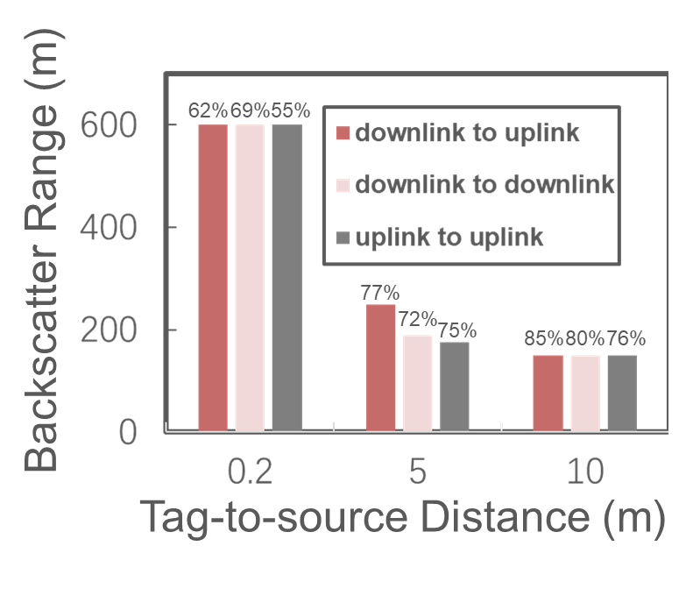
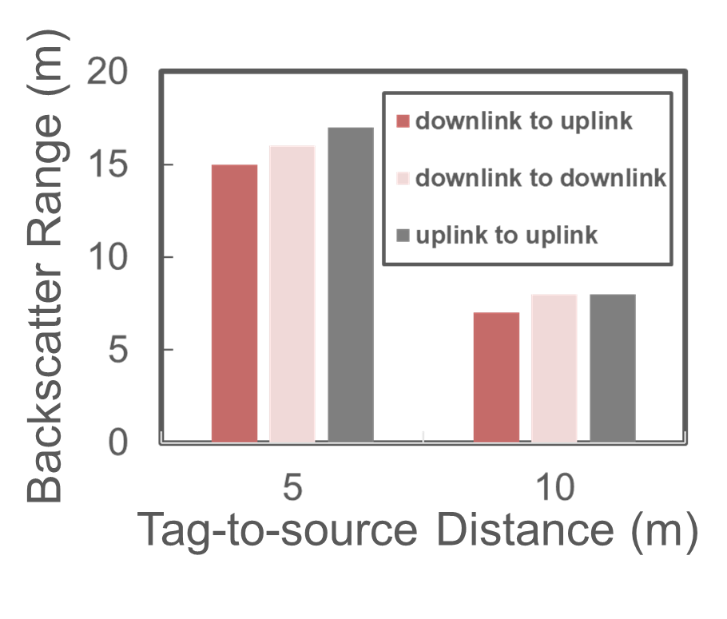
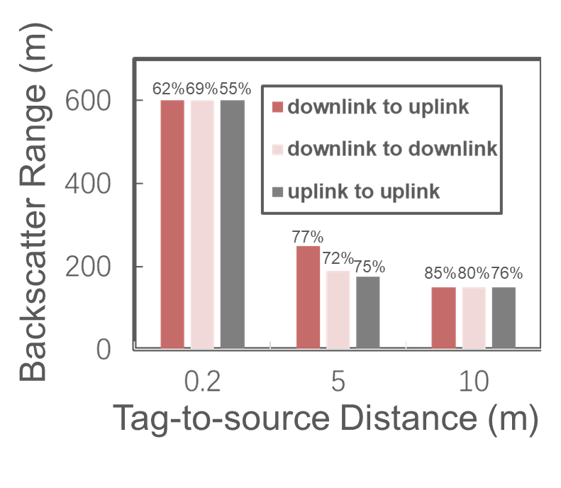
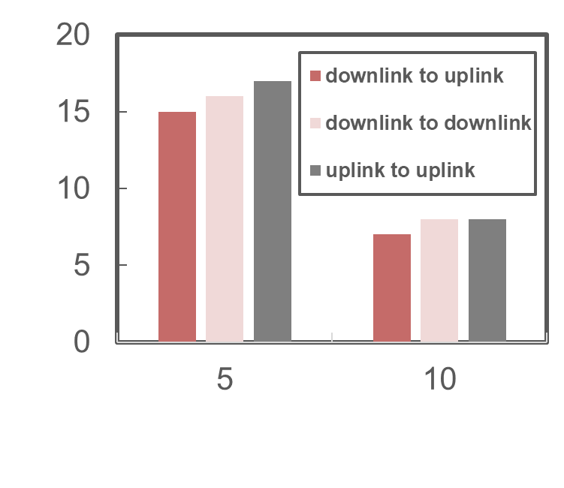
1 End to end field study
How does bit error rate change with the distance?
The maximum backscatter range jumps to 1.1km
Backscatter Range (m)
Penetrate two concrete walls
Penetrate one concrete wall
Tag-to-source Distance (m)
Outdoor LoS Scenario
Indoor Office Building
Notes:
Fog and haze, rainy day, sleety, cloudy, sunny, snowy day.
Test the maximum backscatter range?
1：Maximum backscatter range of the PLoRa tag in an outdoor LoS scenario and associated packet loss rate at maximum range (indicated by number above data point).
2：The maximum backscatter range of the PLoRa tag in an indoor office building.
We also evaluate maximum backscatter range using a USRP2954 with better receive sensitivity (−103 dBm versus −88 dBm), and find that the maximum backscatter range jumps to 1.1km, 1.8× longer than the result achieved by the default USRP2932 gateway used in our experiments

Slide 31
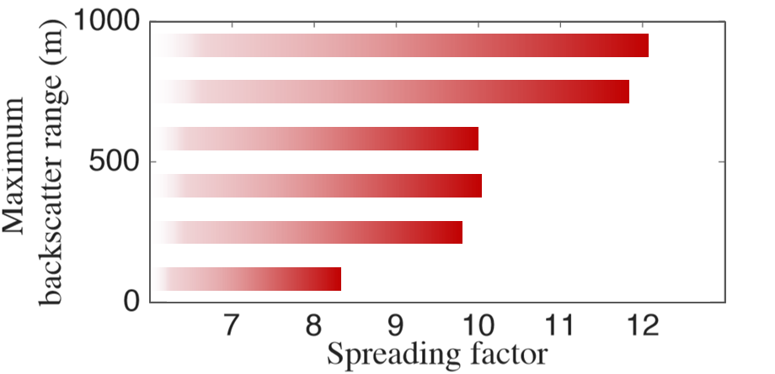
How does bit error rate change with the distance?
The BER varies significantly cross different weather conditions.
Backscatter range VS. Bit rate
Backscatter range VS. Different Outdoor Environment
Notes:
The spread factor is a very important metric. This diagram shows that the maximun backscatter distance is relation to the spread factor.
Look at this line graph. It indicates the relatonship between backscatter range and BER. The ber is rasing with the backscatter distance.
1：It achieves 300m backscatter range at a bit rate of 6.25Kbit/s. when backscatter distance rasing to 800m, the bit rate is droped to 97bit/s.
2： Effective backscatter range in different outdoor environment. the BER increases with distance in all three weather conditions. The BER varies significantly cross different weather conditions.
deliver 284 bytes data every 24 minutes indoors, or every 17 minutes outdoors.

Slide 32
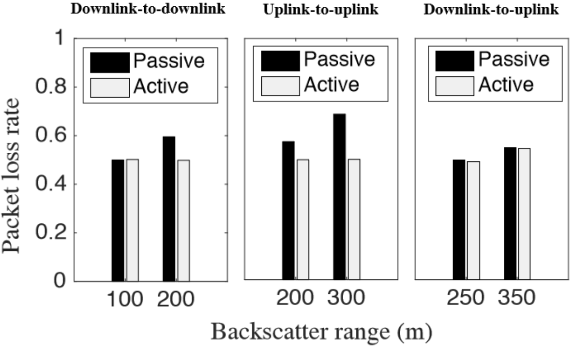
How does the PLoRa tag perform in its intended setting
Passive
Passive
Passive
Active
Active
Active
BER under strong GSM interference VS. Backscatter range
Notes:
Bit error rate under strong GSM interference in the 900MHz ISM band, these are the plr of three communcaton mode for both passive PLoRa and active LoRa packet streams.

Slide 33
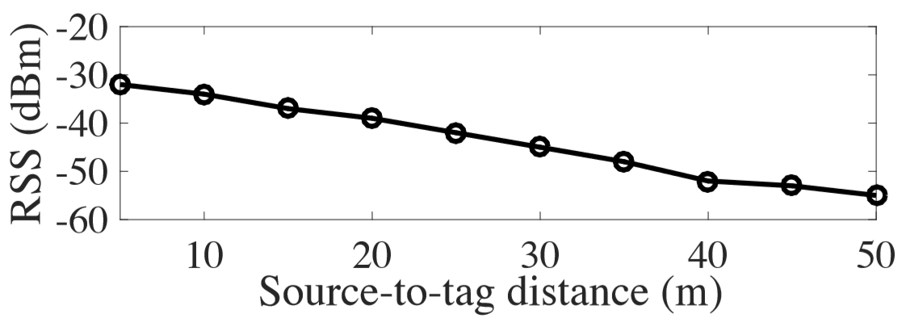
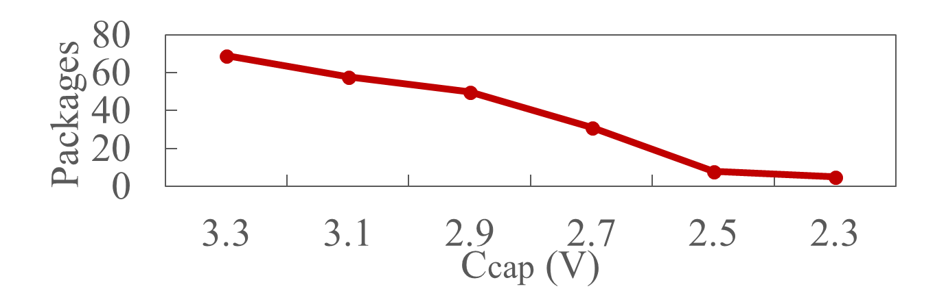
2 Networking Performance
RSS VS. Detector Distance
Backscattered Packages VS. Energy Storage Levels
Notes:
Test the Effective packet detection range and Maximum supported workload
1: Received signal strength at the PLoRa tag versus distance between excitation source and tag.
2: The maximum number of four-byte packets that can be backscattered at various energy storage levels.

Slide 34
3 Power Consumption
288
360
648
Nominal (N) and actual (A) power consumption (mW) of the PLoRa tag and an active LoRa node.
Power Consumption (mW)
Notes:
Bar graph, we have evaluate the System-wide energy consumption. Here is Comparision between active lora node and ptag.
Total nominal and actual power consumption of PLoRais 3.5 µW (microwatt) and 2.591mW (milliwatt), respectively 1000× and 250× (times) smaller than that of a standard LoRa radio.
besides, we have investigate the Energy harvesting efficiency and Super capacitor energy leakage of the system.

Slide 35
Conclusion
Contribution
Proposing a holistic hardware-software co-design to achieve low-power long-range backscatter communication.
Implementing this hardware-software codesign on the PCB board and evaluating its performance.
Limitation
PLoRa’s packet detection range is limited to 50 m
PLoRa’s maximum backscatter range is sensitive
A dedicated packet reception algorithm is needed for backscatter packet decoding
Notes:
Contribution & limitation
PLoRaisanambient,passiveLoRabackscatterdesignthat provideslow-powerandlong-rangeconnectivityforIoTdevices. Our design combines a low-power packet detection circuitwithnovelblindchirpmodulationandharmoniccancellationtechniques.OurPCBprototypecanbackscatterto aLoRagatewayupto1.1kmawayanddeliver284bytesof sensordatawitha17minutedutycycle.

Slide 36



Slide 37
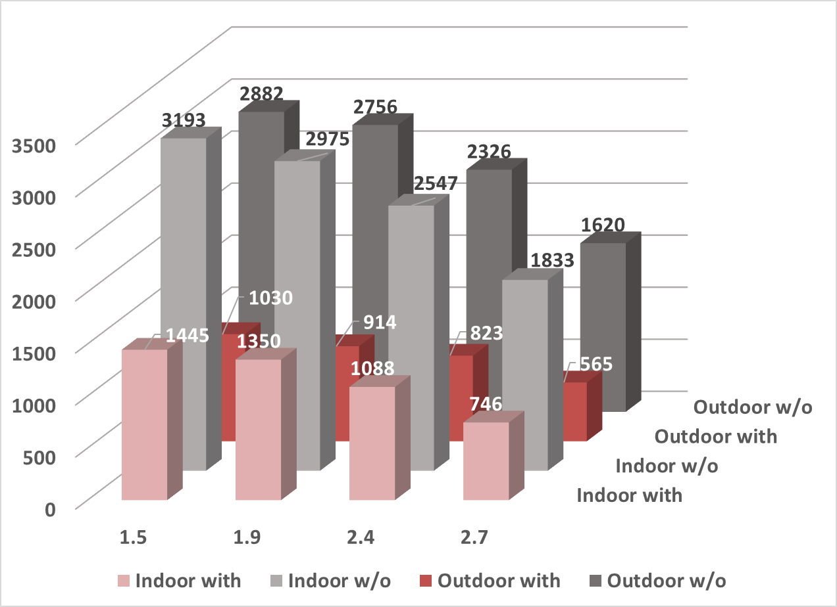
Charging time of PLoRa tag for different initial energy levels
Time (s)
Initial Energy Levels (V)
Notes:
Time required to charge the PLoRa tag from various initial energy levels, with/without the current gate design
System-wide Evaluation. Low-power FPGA simulation. Energy harvesting efficiency. Energy management module efficiency

Slide 38
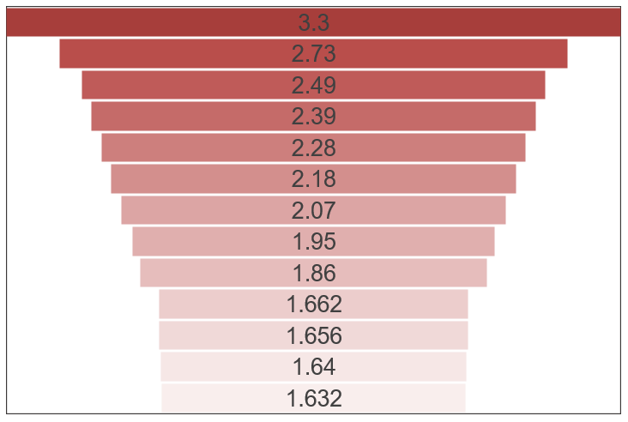
Voltage (V)
0
0.5
1
1.5
2
2.5
3
3.5
4
4.5
5
5.5
6
Energy leakage of the PLoRa tag with time.
Time (h)
1.5V: Minimum voltage required to enable the FPGA

